Slide 1
The Framing of Adult Literacy in Ontario Presented by PhD Candidate Farra Yasin farra_yasin@edu.yorku.ca

Slide 2
Qualitative Research for Dissertation
Research Question: How do Ontario LBS Educators conceptualize literacy learning?
Method of data collection: audio recorded interviews and observations of 14 LBS educators
Method of data analysis: Grounded theory 3-part coding system and constant comparative analysis
Answer: Educators conceptualize literacy LEARNING AS Having a Pragmatic, Cognitive And Social Dimension.
Educators Tend to Apply Critical And Holistic Approaches To Their Practice.

Slide 3
The Word
Is the word a common part of your vocabulary?
When you see the word, what does it make you think about?
Does the word evoke a strong or mild emotional response (can you define the emotion)?
How does the word relate to your life?
Do you recall when you first heard of that word?

Slide 4
The Word
6. Does someone else in the room have that word?
7. Do you think their answers would be similar Or different from yours?
8. Why or why not?
9. Do you think you and that individual might have a shared understanding of the meaning of the word?
10. How might Your gender, Race, Culture, Socio-Economic situation Shape your Understanding of the Word?

Slide 5
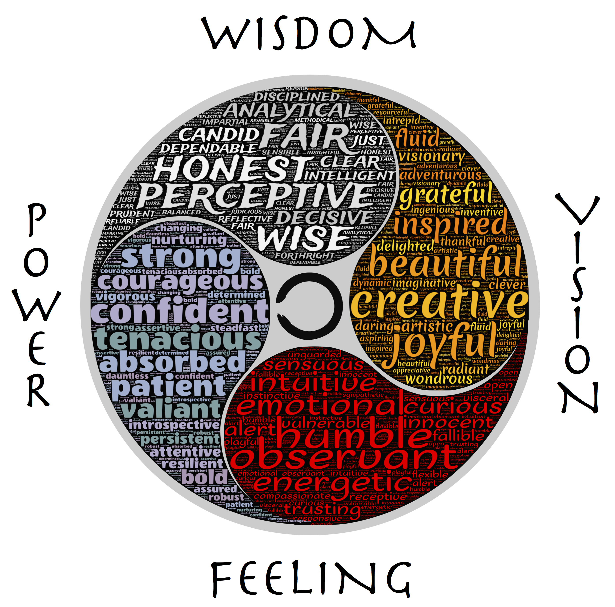
Pragmatic Understanding of Literacy
John Dewey’s theory of experience
the ONLC’s notion of holistic education
Jenny Horsman’s research on trauma
Learner experience was considered as a part of every aspect of the learning process: intake, goal-setting, resource selection, learning plans or strategies, and evaluation
Educators of adults need one-to-one time to dialogue with the learner
(Johnhain, 2015)

Slide 6
Cognitive Aspects of Literacy
Literacy is tied to cognitive processes such as memory and emotion and relates to concepts of self worth and self esteem
Valued holistic approaches to language learning; however, expressed the importance of knowing other cognitive reading strategies
Self-directed learning encourages ownership of the learning products and processes
Standardized Tests and tasks are not great for literacy learning
Similar to cognitive theorists such as (Treiman & Pullatsek, 2015; Habrat, 2013; Hedican, 2014; Sinnot, 2008; and Goldman & Snow, 2015)
COGNITVE READING STrATEGIES:
1Phonics
2 Whole Word
3 WholE LAnGUAGE
4 Holistic

Slide 7
Social Aspects of Literacy
Literacy has a social function
Learners who have experienced social isolation have challenges learning to read and write
Educators need to facilitate peer interaction and social participation in consultation with the learners
Educators referenced critical theorists such as Freire’s Concept Of “TOtAlity”
Totality
Out of School
In School

Slide 8
Experience
Cognitive
Social
To conclude:
Educators conceptualize literacy as a social practice, and cognitive and communicative process that is shaped by learners’ experiences.
Educators TenD to Apply Critical And Holistic Approaches To Their Practice.

Slide 9
ReFERENCES
Dewey, J. (1929). Experience and Nature. New York: Norton. Retrieved from: http://books2.scholarsportal.info.ezproxy.library.yorku.ca/viewdoc.html?id=/ebooks/ebooks0/apa/2011-09-16/1/200911846#tabview=tab1
Dewey, J. (1891). Outlines of a Critical Theory of Ethics. American Psychological Association: Washington. Retrieved from: http://books1.scholarsportal.info.ezproxy.library.yorku.ca/viewdoc.html?id=/ebooks/ebooks0/apa/2012-11-13/1/200912774#tabview=tab1
Goldman, S. & Snow, C. (2015). Adolescent literacy: development and instruction. In R. Treiman & A. Pollatsek (eds.), The Oxford Handbook of Reading. New York: Oxford University Press, 463- 477.
Freire, P. and Macedo, D. (1987). Literacy: reading the word and the world. South Hadley: Bergin and Garvey Publishers.
Freire, P. (1970). Pedagogy of the oppressed. New York: Continuum.
Habrat, A. (2013). The effect of affect on learning: Self-esteem and Self-concept. Piechurska-Kuciel, E. and Szymanska-Czaplak, E. (2013). Language in Cognition and Affect. New York: Springer, pp. 239-255.
Hedican, E. (2014). Eurocentrism in Aboriginal Studies: A Review of Issues and Conceptual Problems. The Canadian Journal of Native Studies, 34 (1), pp. 87-111
Horsman, J. (2000). Too Scared to Learn: Women, Violence, and Education. London: Lawrence Erlbaum Associates
JohnHain (2015). Wheel Enhanced. Retrieved From: https://commons.wikimedia.org/wiki/File:NEW_Wheel_enhanced.png
Ontario Native Literacy Coalition (2017). Indigenized Assessment Tool. Retrieved from: https://onlc.ca/resource-post/ontario-native-literacy-coalition-indigenized-assessment-tool/
Sinnot, J. (2008). Cognitive Representational Development in Adults. In K. Cartwright (eds.), Literacy processes: cognitive flexibility in learning and teaching. New York: Routledge, pp. 42-71.
Treiman, R. & Pollatsek, A. (2015). The Oxford handbook of reading: setting the stage. In R. Treiman & A. Pollatsek (eds.), The Oxford Handbook of Reading. New York: Oxford University Press, 3-9.

