Slide 1
Neoliberal Conceptual Framing and the “Disappearing” of Marginalized Adults from the Basic Adult Education Learning Landscape in Ontario.
Festival of Literacies Presentation of PhD Research Results
May 2018
L. Wyper, PhD

Slide 2
Started in Health Care in Ontario: educating midwifery clients & university students as a clinical preceptor
One of the College of Midwives of Manitoba’s PLAR Supervisor for previous registered midwife from other countries
Moved to ‘teaching’ when I started my own family: community level, then elementary, now adult non-credit for past ten years – Literacy and Basic Skills (LBS) practitioner and now Program Coordinator: LBS and English as a Second Language (ESL) programs
Have taught as Part-time Faculty at Algoma University in CESD on and off since 2012 –now FT Assistant Professor
Educational food activist at community level: Seedy Saturdays, SSM Fallen Fruit Project, SSM Urban Beekeeping Study, etc..
So, nearly 20 years on and off in adult education: clinical (formal), community-based (formal), community-based (non-formal), & school board (formal)
MA at Ontario Institute for Studies in Education (OISE) University of Toronto - action research in a LBS classroom: How violence affects educational outcomes & breaking societal stereotypes around why adults are still in school
Back at OISE / U of T for PhD (graduated March 2018)
Leadership, Higher and Adult Education Department
Adult Education and Community Development Program
Comparative, International and Development Education Collaborative Program / Specialization

Slide 3
sustainable Development
…generally should favor bottom-up over top-down approaches; redistribution over trickle-down; self-reliance over dependency; a local rather than a regional, national, or international focus; and small-scale projects rather than grand-scale or mega-projects. As well, they should be designed with extensive public participation; seek to improve society and the environment as well as the economy; and result in increased equity, equality and empowerment (Brohman, as cited in Roseland, 2012, p.12).

Slide 4
Anti-oppressive practice
…requires an understanding of the nature of oppression, its dynamics, the social and political functions it carries out in the interests of the dominant groups, its effects on oppressed persons, and the ways that oppressed people cope with and/or resist their oppression (Mullaly, 2010, p.16)

Slide 5
Regional differences &
place-based development
Pluralistic communities
Intersectionality
Standardization of LBS policy
Canada as a colonial state & issues of erasure
Globalization, neoliberalism & New Public Management
My Lens:
Anti-oppressive practice
Sustainable development
Anti-oppressive Analysis Framework:
Intersectionality
Pluralistic communities
Regional differences & place-based development
Standardization: first and second order effects
Canada as a colonial state & issues of erasure
Globalisation, neoliberalism and New Public Management

Slide 6
Adult Basic Education as Literacy and Basic Skills programs (LBS) moved from a community development / popular education model in the 1980 and early 1990’s into MTCU funded more formal programming [now called MAESD]
LBS sites reach across three sectors:
College
School Board
Community
And across four streams:
Francophone
Indigenous
Anglophone
Deaf

Slide 7
In 2012 MTCU changed the LBS model towards:
standardization related to intakes
assessments [both formative & summative]
outcomes based data entry
quality assurance [performance management] system

Slide 8
Since 2012 MAESD (for LBS programs) now has:
Suitability criteria *including age criteria
Progress criteria based on formative tasks or evaluations (milestones)
and completions of summative evaluations (culminating tasks)
There are also 5 Goal paths:
Employment
Secondary
Postsecondary
Apprenticeship
Independence

Slide 9
Policy changes with OALCF & EOIS-CAMS as
1st order effects:
“changes in practice or structure
(which are evident in particular sites and across the system as a whole)”
2nd order effects:
“the impact of these changes on patterns of social access and opportunity and social justice”
(Ball, 2006)

Slide 10
Overarching Research Questions
1. What changes in practices have administrators/practitioners at LBS sites
observed and how do they believe these changes are related to changes in
provincial LBS policies?
2. How have the demographics of the students served changed? Are some
subgroups of students served more or less frequently than before?
3. What strategies are staffs at LBS sites using to resist and/or mitigate
the changes?

Slide 11
Case Study with semi-structured interview scenarios or “vignettes”
Sites picked:
12 North by sector & stream
12 South by sector & stream
= 24 site administrators and/or practitioners
Comparative North vs South component defined by Literacy Network designation
In the end 22 interviews were done representing the 24 sites
*but in fact as site administrators often represent many sites interviewees actually represent approximately 50 LBS sites.

Slide 13
Scenario one
An English as a Second Language (ESL) student seeks out LBS service at your site for an employment-based class you are running. They are presently receiving ESL lessons in an ESL program funded by the Ministry of Citizenship and Immigration (MCI). They were assessed in their ESL program as a Canadian Language Benchmark (CLB) 4.
What would you do?

Slide 14
Scenario two
An adult comes in (with their worker, from a community based agency that supports developmentally delayed adults live independently) and seeks out LBS service at your site to learn to read and make change. On assessment you find they cannot write their name or recognize numbers to twenty.
What would you do?

Slide 15
Scenario three
A senior aged 67, from the community seeks out LBS service at your site for computer upgrading. They just want to learn how to turn a computer on, use a mouse, serf the Internet a bit, and learn how to use their iPad to connect with grandchildren across the country.
What would you do?

Slide 16
Scenario four
An adult comes in (with their worker, from a community based agency that supports adults transitioning from incarceration to living independently again) and seeks out LBS service at your site to upgrade before going on for their OSSD. You are familiar with this learner as they were at your agency years ago. Their past attendance was extremely irregular, they had addictions challenges, they eventually just did not come back, and you could not reach them for follow-up as their number had been out of service at the time.
What would you do?

Slide 19
Spectrum of ESL scenario responses: From “I would have to refer them back; in order to eligible for our programs they have to be Canadian Language Benchmark six.” To “We are going to serve our community”

Slide 21
Spectrum of Developmentally delayed adults scenario responses: From “We are not a respite service” To “I would not say it created a gap; I would say it created a chasm”

Slide 23
Spectrum of Seniors scenario responses: From “Referred them to the public library system that has computer basics for seniors programs.” To “It’s a big gap because it used to be that we were allowed to go out and do these things but now because suitability numbers are really important people are going ‘we can’t unless you can guarantee us that the majority of them will be under 65’.”

Slide 25
Spectrum of History of Incarceration Scenario responses
From
“They would be welcomed back into the program”
To
“I’ve never worked with anybody that was incarcerated”

Slide 26
A surprising additional scenario:
I keep hearing the theme of young adults and adult learners
‘being pushed through high school’
“Somehow they have an OSSD but they cannot write a sentence or do simple math”

Slide 27
Implications
Standardization in pluralistic societies
Second order effects: North, South, and Rural
Types of resistance and gatekeeping: Practitioner response and practice
Access to and definitions of literacy needs in multimodal, multi-literacies world: who is a literacy learner and what is literacy learning?
Balancing acts: Community & MAESD; needs and expectations

Slide 28
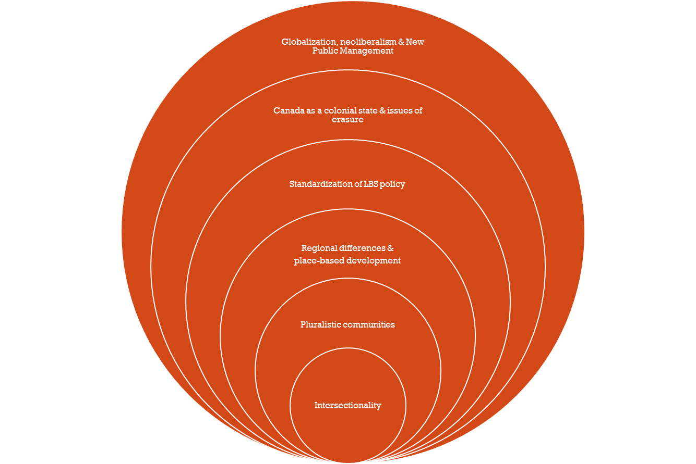
Recommendations:
Stop perpetuating colonial & neoliberal oppressions, marginalizations and erasures through government policy (top-down development)
Ensure that LBS working groups are truly the voices of communities
(not co-opted with MEASD agendas)
LBS sites reflect pluralistic community need
(sustainable development principles)

Slide 29
References
Wyper, L. (2018). Neoliberal Conceptual Framing and the “Disappearing” of Marginalized Adults from the Basic Adult Education Learning Landscape in Ontario (Doctoral dissertation, OISE / University of Toronto, Ontario, Canada). Retrieved from URI: http://hdl.handle.net/1807/87302
Ball, Stephen. (2006). What is Policy? Texts, Trajectories and Toolboxes. Discourse: Studies in the Cultural Politics of Education.13(2), 10-17.
Mullaly, B. (2010). Challenging Oppression and Confronting Privilege: A Critical Social Work Approach (2nd ed.). Don Mills, ON: Oxford University Press.
Roseland, M. (2012). Toward Sustainable Communities: Solutions for Citizens and their Governments (4th ed.). Gabriola Island, BC: New Society Publishers.

